Slide 1
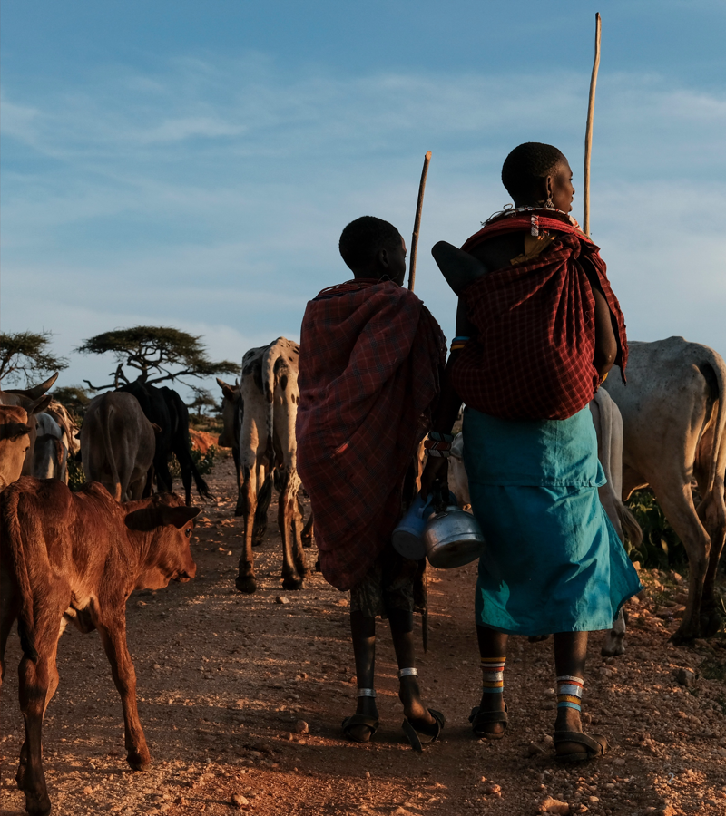

Is it an outbreak?
MODULE 6 · DAYS 6–7
Core SNPs, recombination, trees, SNP distances with Snippy and SKA2, and what to tell the IPC team
Neonatal AMR genomic surveillance of K. pneumoniae and E. coli
KlebGen training · Africa CDC and ILRI
Module 6 · Phylogenetics and outbreak detection | Days 6–7
Notes:
Module 6 runs over two days. Day 6 builds the evidence: a core-genome SNP alignment, recombination removed, a tree and SNP distances, checked with a second, reference-free method. Day 7 interprets it: tree plus ward and dates, when the cluster started, and how to present the finding to an infection prevention and control team.

Slide 2

Days 6–7 at a glance
Day · session | Time | Topic
Day 6 · 1 | 09:00–10:30 | From reads to a core-genome SNP alignment (Snippy)
Day 6 · 2 | 11:00–12:30 | Recombination and why it matters (Gubbins)
Day 6 · 3 | 13:30–15:00 | Maximum-likelihood trees (IQ-TREE)
Day 6 · 4 | 15:30–17:00 | SNP distances, a reference-free check with SKA2, and what a threshold can tell you
Day 7 · 1 | 09:00–10:30 | Tree plus metadata: classify clusters (Microreact)
Day 7 · 2 | 11:00–12:30 | When did the cluster start? Time-scaled trees (BactDating)
Day 7 · 3 | 13:30–15:00 | Writing the outbreak summary
Day 7 · 4 | 15:30–17:00 | Role play: presenting to an infection prevention and control (IPC) team
You will produce
a recombination-filtered tree and SNP-distance matrix for ST39, a Snippy–SKA2 comparison, and a one-page outbreak summary
Module 6 · Phylogenetics and outbreak detection | Days 6–7
2
Notes:
Day 6 (white rows) builds the tree and the distances; Day 7 (shaded rows) interprets them with the epidemiology. The worked example both days is the ST39 group from the Blantyre study, with a candidate cluster in the Chatinkha Nursery in 2017.

Slide 3
By the end of Module 6 you can
1
Choose a reference genome and build a core-genome SNP alignment.
2
Explain why recombination inflates SNP counts, and remove it with Gubbins.
3
Build a maximum-likelihood tree with branch support.
4
Use SNP distances, from Snippy and from reference-free SKA2, as evidence, not proof, of transmission.
5
Combine tree, distances, ward and dates to classify clusters; date a cluster when the temporal signal allows.
6
Communicate a genomic finding to an IPC team in plain language, with clear actions.
1–4: Day 6
5–6: Day 7
Module 6 | Days 6–7
3
Notes:
Objectives 1 to 4 are Day 6; 5 and 6 are Day 7.

Slide 4

Genomic epidemiology in action
DONE: DAYS 1–5
Assemblies used to
NOW: MODULE 6
1 · Confirm the species
A core-genome SNP alignment per ST
2 · Find resistance and virulence genes
→ a SNP-distance matrix and a tree
3 · Assign the sequence type
→ are these infections linked?
4 · Predict serotypes (K and O, Day 8)
K. pneumoniae recombines: unless recombined regions are found and masked, the alignment counts their SNPs as mutations.
Module 6 · Phylogenetics and outbreak detection | Days 6–7
4
Notes:
Everything so far described single isolates. Module 6 compares isolates with each other, which is what outbreak detection needs. Use phylogenetic methods that work on SNP alignments, and remove recombination first: that is Session 2 today.

Slide 5

Investigating transmission: two approaches
SNP distances
Phylogeny
The simplest: count the SNPs between each pair of isolates.
A tree from the core-genome alignment: the whole pattern of relationships.
A cut-off flags pairs likely linked by recent transmission.
One number per pair; says nothing about who came first.
Shows clusters, background isolates, and with dates, timing.
Misleading if recombination is ignored.
We use both, from the same alignment, and read them with the epidemiology: ward, dates, length of stay.
Module 6 · Phylogenetics and outbreak detection | Days 6–7
5
Notes:
Distances and trees come from the same recombination-filtered alignment, so they agree; they answer different questions. Neither proves transmission by itself: combined with overlapping hospital stays or a shared ward, they can help resolve an outbreak.

Slide 6

A core-genome SNP alignment
DAY 6 · SESSION 1 · 09:00–10:30
Choosing a reference and mapping with Snippy
Module 6 · Phylogenetics and outbreak detection | Day 6
6
Notes:
Session 1. Every isolate is compared with one reference genome; positions present in all isolates form the core genome, and the differences there are the SNPs we count.

Slide 7

The worked example: 12 ST39 isolates
Role | Isolates
Candidate cluster: Chatinkha Nursery, 2017 | CAA65Z CAA99X CAA47J CAA4X5 CAA574 CAA5XX CAA5YM CAA4GD
Background ST39 | D29438 (2005), BKR8JH (2016)
Other ST39 | BHB7VE (2016, NDM-1), CHI11E (2019, hybrid)
Build trees within one ST. Between distant STs, recombination dominates and SNP counts run into the tens of thousands: that says nothing about transmission.
Module 6 · Phylogenetics and outbreak detection | Day 6
7
Notes:
The pipeline does the same automatically: Kleborate's species and ST define one group per ST. The background isolates are the controls: if the cluster is real, they should sit clearly further away than the cluster isolates are from each other.

Slide 8

Choosing a reference
1 · SPECIES
2 · REFERENCE SHEET
3 · NTUH-K2044
From Kleborate (Day 3): all 12 are K. pneumoniae
conf/phylo_references.csv: species row, or an ST row if there is one
AP006725.1: one complete chromosome, ~5.25 Mb
Chromosome only
Would an ST39 reference be better?
Plasmids are gained and lost too often to share the chromosome's history.
Usually: NTUH-K2044 is ST23, so the core is smaller. Cluster conclusions rarely change.
Module 6 · Phylogenetics and outbreak detection | Day 6
8
Notes:
We choose the reference exactly as the pipeline does, so the hand-built tree can be compared with the pipeline's Kpneumoniae_ST39 result. Genes ST39 has and NTUH-K2044 lacks cannot be compared, but within one ST the SNPs that separate isolates mostly fall in shared genes. An ST-specific reference, such as the CHI11E hybrid chromosome, can be added as an ST row in the reference sheet.

Slide 9
Hands-on: map reads with Snippy
use_tools phylo
mkdir -p $RESULTS/06_phylogeny/ST39 && cd $RESULTS/06_phylogeny/ST39
cp $SHARED/references/AP006725.1.fasta ref_NTUH-K2044.fasta
# Your practice isolates (all ST39): 20–45 minutes each
for s in $PRACTICE; do
snippy --outdir snippy/$s --ref ref_NTUH-K2044.fasta \
--R1 $COURSE/trimmed/${s}_R1.fastq.gz --R2 $COURSE/trimmed/${s}_R2.fastq.gz \
--cpus $THREADS --force
done
use_precomputed 06_phylogeny/ST39/snippy # the other nine
for s in $ST39; do echo -e "$s\t$(grep -c -v '^CHROM' snippy/$s/snps.tab)"; done
Thousands of SNPs each against an ST23 reference is expected. All 12 should be similar: an outlier needs a closer look (coverage, contamination, wrong ST).
Module 6 · Phylogenetics and outbreak detection | Day 6
9
Notes:
Set ST39 first, as on the Day 6 page: ST39="CAA65Z CAA99X CAA47J CAA4X5 CAA574 CAA5XX CAA5YM CAA4GD D29438 BKR8JH BHB7VE CHI11E". What matters is how the ST39 isolates differ from each other after the core alignment, not their distance from the reference. For genomes that exist only as assemblies, the pipeline runs snippy --ctgs on the contigs instead of reads.

Slide 10
The core alignment
snippy-core --ref ref_NTUH-K2044.fasta --prefix core snippy/*
cat core.txt # per isolate: aligned length, how much is missing
snippy-clean_full_aln core.full.aln > clean.full.aln
core.aln
core.full.aln
Only the variable sites in the core genome: positions covered in every isolate.
The whole reference length for every isolate, with invariant sites and gaps.
Small; for raw SNP distances.
Gubbins needs this: it looks for regions where SNPs are unusually dense.
Module 6 · Phylogenetics and outbreak detection | Day 6
10
Notes:
snippy-clean_full_aln replaces unusual characters (lower-case, N and other ambiguity codes) with a gap symbol that Gubbins understands. core.txt is a quick quality check: an isolate with a much shorter aligned length than the rest had low coverage or is a different lineage.

Slide 11

Recombination and why it matters
DAY 6 · SESSION 2 · 11:00–12:30
Detecting and removing it with Gubbins
Module 6 · Phylogenetics and outbreak detection | Day 6
11
Notes:
Session 2. Bacteria occasionally take up DNA from other bacteria. Phylogenetic methods assume differences come from mutation along a tree, so imported DNA has to be found and removed before the tree and distances can be trusted.

Slide 12
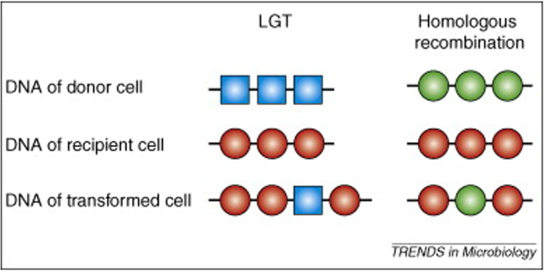
Recombination
The incorporation of DNA from a donor cell into the genome of a recipient cell.
Homologous recombination
The donor sequence replaces the similar region in the recipient. Mostly affects core genes.
Lateral (horizontal) gene transfer
Adds new genes. Brings accessory genes: resistance, plasmids.
Vos M. Trends Microbiol 2009. doi:10.1016/j.tim.2009.03.001
Module 6 · Phylogenetics and outbreak detection | Day 6
12
Notes:
For the tree, homologous recombination is the problem: it swaps a stretch of the core genome for another strain's version, bringing many SNPs at once into the very positions we align. Horizontal gene transfer adds genes outside the core, which is what Module 5 traced with plasmids; it does not enter a core alignment, but the same transfer mechanisms deliver the DNA for both.

Slide 13
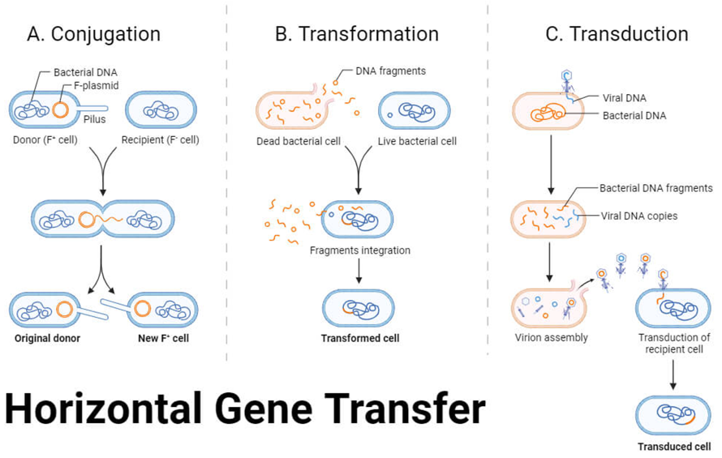
How DNA moves between bacteria
Conjugation
Cell to cell, often by plasmid (Module 5)
Transformation
Free DNA taken up from dead cells
Transduction
Carried by a bacteriophage
Source: microbenotes.com
Module 6 · Phylogenetics and outbreak detection | Day 6
13
Notes:
All three routes deliver foreign DNA into a cell. What happens next decides its effect on our analysis: DNA that stays separate (a plasmid) or inserts as new genes adds accessory content; DNA that pairs with a similar stretch of the chromosome replaces it by homologous recombination, which changes the core alignment. Integrating a new segment into the chromosome usually needs similar flanking sequence on both sides. In Klebsiella, conjugative plasmids are the main route for resistance genes.

Slide 14
Why recombination misleads a tree
One recombination event can import dozens or hundreds of SNPs at once.
COUNTED AS MUTATIONS
IGNORED
SO
Two isolates look as if they diverged long ago: less related than they are.
The tree misrepresents the true clonal relationships between isolates.
Detect recombined regions and account for them before building the tree.
Module 6 · Phylogenetics and outbreak detection | Day 6
14
Notes:
Mutations accumulate slowly and at a roughly steady rate; that is what lets SNP counts stand for time. A recombination block arrives in one step, so its SNPs say nothing about time. The core genome alignment we built in Session 1 still contains these blocks.

Slide 15
Detecting recombination: two families
Phylogenetic networks
Clonal-frame methods (used here)
Show where the data conflict with a single tree: alternative histories to check with other methods.
Model the genome as inherited along a tree (the clonal frame), with imported stretches on some branches.
RDP4: several algorithms, finds parents and breakpoints of recombinant sequences.
Gubbins: finds regions where SNPs are denser than mutation explains.
Does not scale to large sets of bacterial genomes; mostly used for viruses.
ClonalFrameML: estimates recombination on a starting tree by maximum likelihood.
Module 6 · Phylogenetics and outbreak detection | Day 6
15
Notes:
Network methods are useful for exploring a small number of sequences, but they do not give a recombination-free alignment for a bacterial outbreak. Clonal-frame methods do: they work on whole-genome alignments of closely related isolates and mark the recombined regions so they can be removed. Gubbins is the standard for bacterial outbreak work and is what the pipeline runs; ClonalFrameML is a common alternative.

Slide 16

How Gubbins works
1
2
3
4
Build a tree from the whole alignment
Reconstruct the ancestors: which SNPs arose on which branch
Scan each branch for windows with too many SNPs: recombination
Mask them, rebuild the tree; repeat until it stops changing
The result: SNPs outside recombination, a tree built from them, and a map of where and on which branch each recombination happened.
Module 6 · Phylogenetics and outbreak detection | Day 6
16
Notes:
The idea: point mutations are scattered roughly evenly along the genome, so on any one branch a dense run of SNPs is unlikely to come from mutation. Gubbins tests sliding windows on each branch against the background SNP density and marks the dense ones. Because the tree affects which SNPs belong to which branch, it iterates. Gubbins works best on closely related isolates, such as one ST.

Slide 17
Hands-on: Gubbins
run_gubbins.py --prefix ST39 --threads $THREADS clean.full.aln
# How many recombination events, and how many SNPs did they carry?
grep -vc "^#" ST39.recombination_predictions.gff
awk -F'\t' 'NR>1 {inr+=$3; outr+=$4} END {print "SNPs outside:", outr, " inside:", inr}' \
ST39.per_branch_statistics.csv
File | Contents
ST39.recombination_predictions.gff | Where recombination was found, and on which branch
ST39.filtered_polymorphic_sites.fasta | SNP alignment with recombination removed
ST39.final_tree.tre | Gubbins' own tree
ST39.per_branch_statistics.csv | SNPs inside and outside recombination, per branch
Module 6 · Phylogenetics and outbreak detection | Day 6
17
Notes:
Despite its name, per_branch_statistics.csv is tab-separated. Check the column names first with head -1 ST39.per_branch_statistics.csv | tr '\t' '\n' | cat -n: the awk assumes column 3 is SNPs inside recombination and column 4 SNPs outside; adjust if your Gubbins version differs. The filtered polymorphic sites file is the input to IQ-TREE in the next session.

Slide 18

Maximum-likelihood trees
DAY 6 · SESSION 3 · 13:30–15:00
Building and reading a tree with IQ-TREE
Module 6 · Phylogenetics and outbreak detection | Day 6
18
Notes:
Session 3. From the recombination-filtered SNPs we build a maximum-likelihood tree: the tree under which the observed SNPs are most probable, given a model of how bases change. Bootstrap values say how well the data support each branch.

Slide 19
Hands-on: IQ-TREE
snp-sites -c ST39.filtered_polymorphic_sites.fasta > ST39.core_snps.fasta
iqtree -s ST39.core_snps.fasta -m GTR+G+ASC -B 1000 -T $THREADS --prefix ST39
ls ST39.treefile ST39.contree # older installs: iqtree2
snp-sites -c
GTR+G
Keeps only variable sites with A, C, G or T in every isolate.
How bases change: a general model, with rates varying between sites.
+ASC
-B 1000
Corrects for using only variable sites, so branch lengths are not overestimated.
1000 ultrafast bootstraps: support for each branch.
Module 6 · Phylogenetics and outbreak detection | Day 6
19
Notes:
+ASC (ascertainment-bias correction) is needed whenever the alignment contains only variable sites; without it IQ-TREE assumes the invariant sites do not exist and stretches the branches. It fails if any column is invariant, which is why snp-sites -c comes first. .treefile is the best tree; .contree is the bootstrap consensus.

Slide 20

Reading the tree
Tips
Branch length
The isolates, plus a tip called Reference from Snippy.
Amount of change: read it from the scale bar. Short branches = few SNPs.
Support
Root
Ultrafast bootstrap of 95 or more: a well-supported branch.
IQ-TREE gives an unrooted tree: root it on an outgroup (D29438, 2005) or at the midpoint to read time direction.
Open ST39.treefile in iTOL or FigTree now; tomorrow in Microreact, with the ward and dates.
Module 6 · Phylogenetics and outbreak detection | Day 6
20
Notes:
Ask: do the eight cluster isolates form one clade of short branches? Where do the background isolates sit? Is the clade well supported? Within a tight outbreak cluster, bootstrap values are often low because the isolates differ by very few SNPs; that means the order inside the cluster is uncertain, not that the cluster is not real.

Slide 21
SNP distances and SKA2
DAY 6 · SESSION 4 · 15:30–17:00
What a threshold can tell you, and a reference-free check
Module 6 · Phylogenetics and outbreak detection | Day 6
21
Notes:
Session 4. We count SNPs between every pair of isolates, see what a threshold does and does not mean, and repeat the count with SKA2, which needs no reference. A conclusion that holds with both methods is a stronger one.

Slide 22
Hands-on: SNP distances
snp-dists ST39.core_snps.fasta > ST39_snp_dists_filtered.tsv # after Gubbins
snp-dists core.aln > ST39_snp_dists_raw.tsv # before
# Then (awk on the Day 6 page, 6.7): one row per pair, labelled by pair type → ST39_pairs.tsv
Fill in, for the filtered distances:
Pair type | Minimum | Median | Maximum
within_cluster
cluster_vs_other
other_vs_other
Module 6 · Phylogenetics and outbreak detection | Day 6
22
Notes:
The awk script in section 6.7 turns the square matrix into one row per pair, labels each pair as within the candidate cluster, cluster versus other ST39, or other versus other, and prints the minimum, median and maximum per type. Then compare raw and filtered: how much did removing recombination change the distances? Fell behind? use_precomputed 06_phylogeny/ST39 copies every missing file.

Slide 23
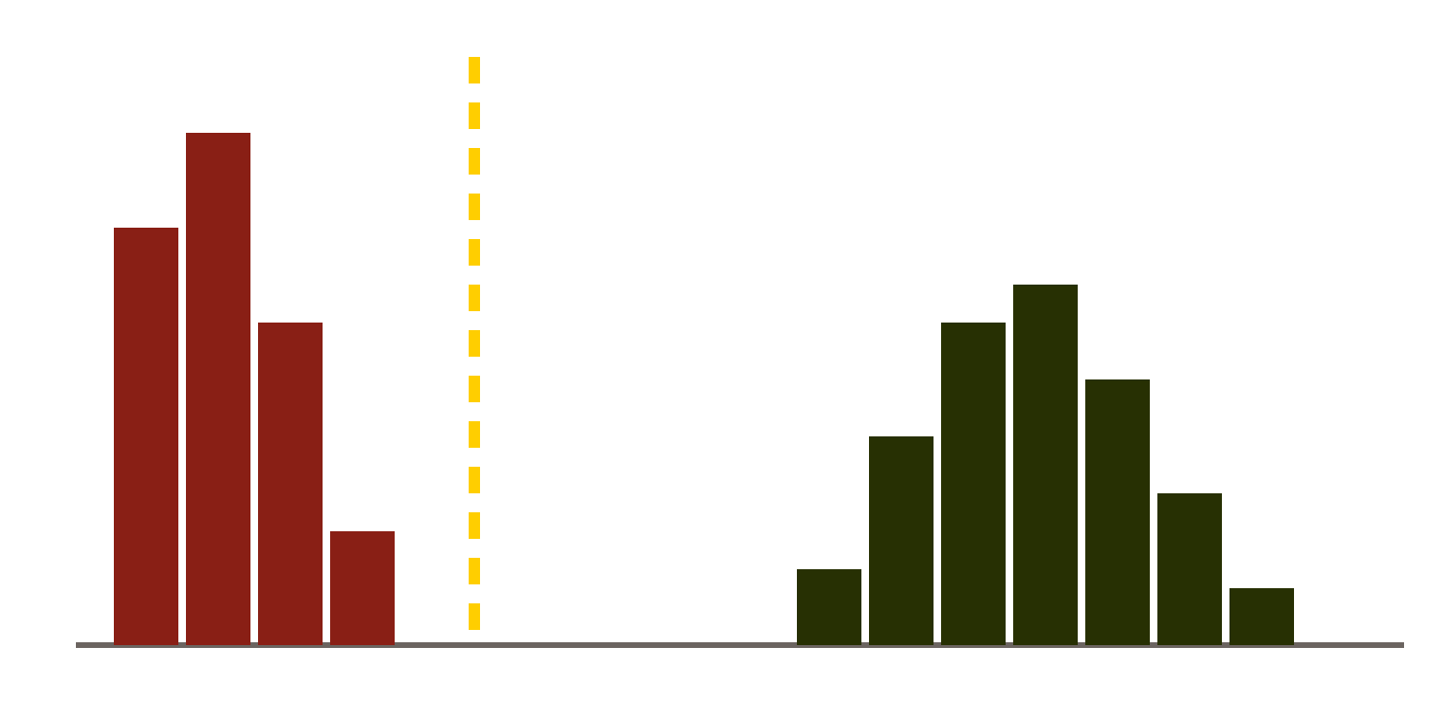

What does a SNP threshold mean?
A cut-off is set a priori (earlier outbreaks, the organism) or empirically (the gap in this histogram).
Genome size, mutation and recombination rates differ: no single cut-off fits all species.
K. pneumoniae: fewer than about 20–25 core SNPs is often used to flag possible recent transmission.
Close pairs
cut-off in the gap
Unrelated pairs · SNPs →
Illustrative: distances are often bi- or tri-modal.
A threshold flags pairs for epidemiological review. It never declares an outbreak on its own.
Module 6 · Phylogenetics and outbreak detection | Day 6
23
Notes:
The histogram is a drawing, not our data: plot the real one from ST39_pairs.tsv. The right threshold depends on the lineage, the mutation rate, how much of the genome is compared, and the time between samples: isolates a year apart are expected to differ by a few more SNPs than isolates a week apart. Combined with epidemiological data, such as overlapping stays on the same ward, distances help resolve an outbreak. Discuss: do the eight cluster isolates fall within a few SNPs of each other? Are the 2005 and 2016 isolates clearly further away?

Slide 24
SKA2: SNPs without a reference
Every genome is cut into split k-mers: 31 bases with the middle base left out. Same 30 flanking bases, different middle base = a SNP.
Isolate A
ATGCCGTAAGCTTGA
C
TCGGATACCGTTAGC
Isolate B
ATGCCGTAAGCTTGA
T
TCGGATACCGTTAGC
15 identical bases · the SNP · 15 identical bases
No reference: compares everything two isolates share
Fast; reads or assemblies
Best for closely related isolates, such as one ST
Module 6 · Phylogenetics and outbreak detection | Day 6
24
Notes:
The sequences on the slide are made up to show the idea. Because SKA2 never maps to a reference, its distances include genes and plasmids the reference lacks. The flip side: a split k-mer needs 15 identical bases on each side, so SNPs close to another variant, and indels, are missed. Derelle et al., Genome Research 2024, describe the method.

Slide 25
Hands-on: SKA2 on the ST39 group
# 1. Split k-mers of every isolate, from its best assembly (name <tab> file)
for s in $ST39; do printf '%s\t%s\n' $s $COURSE/best/$s.fasta; done > ska_inputs.tsv
ska build -f ska_inputs.tsv -o ST39_ska -k 31 --threads $THREADS
# 2. SNP distance for every pair: Sample1, Sample2, Distance, Mismatches
ska distance ST39_ska.skf -o ST39_ska_distances.tsv
# 3. SKA2 next to Snippy + Gubbins, pair by pair
awk -F'\t' 'NR == FNR { if (FNR > 1) { k = ($1 < $2) ? $1" "$2 : $2" "$1; ska[k] = $3 }; next }
{ k = ($1 < $2) ? $1" "$2 : $2" "$1; print $1"\t"$2"\t"$3"\t"ska[k]"\t"$4 }' \
ST39_ska_distances.tsv ST39_pairs.tsv > ST39_snippy_vs_ska.tsv
ska build: one .skf file holding every isolate's split k-mers
ska distance: SNPs between each pair, no reference, no tree
awk: matches pairs in either order and puts both distances side by side
Module 6 · Phylogenetics and outbreak detection | Day 6
25
Notes:
Short of time? use_precomputed 06_phylogeny/ST39/ST39_ska.skf 06_phylogeny/ST39/ST39_ska_distances.tsv. SKA2 builds from assemblies here; it can also read FASTQ files. The output columns of ST39_snippy_vs_ska.tsv are isolate1, isolate2, Snippy + Gubbins distance, SKA2 distance and pair type; the Day 6 page shows how to print it with a header.

Slide 26
Why SKA2 and Snippy distances differ
SKA2 LARGER
SKA2 LARGER
SKA2 SMALLER
Recombination
More genome
Dense regions
SKA2's distances are raw; Gubbins removed recombination from Snippy's.
It also compares genes and plasmids the reference chromosome lacks.
SNPs near another variant, and indels, break the 15-base flanks and are missed.
What matters: do both methods rank the pairs the same, and put the cluster a few SNPs apart and the background far away?
Module 6 · Phylogenetics and outbreak detection | Day 6
26
Notes:
Ask the room first: are the SKA2 distances larger or smaller, and why? Several effects pull in different directions, so the absolute numbers will differ. If both methods agree on which pairs are close, the conclusion about transmission does not depend on the method.

Slide 27

Both methods for every group: the pipeline
# run with --phylo_method both: <group>/ from Snippy, <group>_ska2/ from SKA2
P=$SHARED/precomputed/pipeline_results/06_phylogeny
python3 $SHARED/neonatal-amr-nf/bin/compare_snp_methods.py --phylo $P \
--threshold 20 --out $RESULTS/06_phylogeny/snippy_vs_ska2
ska map
Summary per group
In the pipeline, SKA2 places its k-mers on the same reference, so Gubbins, IQ-TREE and snp-dists run on it too.
Spearman correlation (1 = same ranking), typical and largest difference, pairs ≤ 20 SNPs by each method.
Close by one method only? Treat the pair as uncertain: check both trees, both Gubbins recombination maps, and the isolates' QC.
Module 6 · Phylogenetics and outbreak detection | Day 6
27
Notes:
The trainers ran the training set with --phylo_method both. The pairs table has one row per pair with both distances after Gubbins, plus SKA2's reference-free distance (ska2_ref_free). A recombination block detected in one alignment but not the other moves many SNPs at once; low coverage or a mixed sample affects the two methods differently. A conclusion about transmission should hold with either method; if not, report that it depends on the method. Country runs from Day 5 can be repeated with PHYLO_METHOD=both.

Slide 28
Tools for SNP distances and trees
Tool | How it finds SNPs | Input | Where
Snippy + Gubbins, IQ-TREE | Maps to one reference; core SNPs; recombination removed | Reads, or contigs (--ctgs) | Command line, the pipeline
SKA2 | Split k-mers; reference-free distances, or mapped (ska map) | Reads or assemblies | Command line, the pipeline
CSI Phylogeny 1.4 | Maps with BWA; filters SNPs, keeps positions checked in every genome; ML tree | FASTQ or contigs | Web: CGE
CSI Phylogeny needs no installation, but has no recombination removal: fine for a first look at a few isolates.
Module 6 · Phylogenetics and outbreak detection | Day 6
28
Notes:
CSI Phylogeny, from the Center for Genomic Epidemiology, uploads genomes to a web server: check your country's rules before uploading patient isolates. It calls SNPs per genome, keeps only positions that pass in all genomes, and builds a maximum-likelihood tree; its SNP filters can be adjusted. For a recombining species such as K. pneumoniae, a recombination-filtered alignment from Snippy and Gubbins, checked with SKA2, is the stronger evidence.

Slide 29
Tree plus metadata
DAY 7 · SESSION 1 · 09:00–10:30
Microreact, and classifying each cluster
Module 6 · Phylogenetics and outbreak detection | Day 7
29
Notes:
Day 7. Yesterday's genomic evidence means little on its own: transmission needs isolates that are genetically close AND close in place and time. Today we put the tree next to ward and year.

Slide 30
Hands-on: tree and metadata in Microreact
cd $RESULTS/06_phylogeny/ST39
# CSV: first column 'id' (matches the tree's tips), year column 'year', every field quoted
awk -F'\t' 'BEGIN{OFS=","} NR==1 {$1="id"; $2="year"} {for(i=1;i<=NF;i++) $i="\""$i"\""; print}' \
$COURSE/training_data/metadata_compact.tsv > microreact_metadata.csv
1
2
3
microreact.org → Upload
Drop in ST39.treefile and microreact_metadata.csv
Colour by ward, then by year; add a timeline
Module 6 · Phylogenetics and outbreak detection | Day 7
30
Notes:
Every field is quoted because some K-locus values contain commas. The tree has a tip called Reference (from Snippy) with no metadata row; that is fine. Microreact shows the tree, a timeline and a table side by side: click a clade and its rows light up. With country data, check what may be uploaded to a public web service before using it.

Slide 31
Classifying a cluster
Evidence | Probable transmission | Possible transmission | Unlinked
Core SNP distance | Within threshold | Near threshold | Well above threshold
Place | Same ward | Same hospital, different ward | Different facilities
Time | Overlapping or close dates | Months apart | Years apart
Check the method too: a pair close by Snippy but not by SKA2 (or the reverse) is at most possible transmission until you know why.
Module 6 · Phylogenetics and outbreak detection | Day 7
31
Notes:
All three kinds of evidence must point the same way for probable transmission. The pipeline's transmission_pairs.R applies the same logic to every pair automatically: close SNPs, same ward and close in time is probable; near SNPs is possible; close but different or unknown ward, or years apart, is linked with the route unclear. Use Day 6's snippy_vs_ska2_pairs.tsv for the method check.

Slide 32
Exercise: classify the ST39 group
Isolate(s) | SNPs to nearest cluster member | Ward | Year | Classification | Reason
Cluster (8) |  | Chatinkha Nursery | 2017
BKR8JH |  | Chatinkha Nursery | 2016
D29438 |  | unknown | 2005
BHB7VE |  | 4A Female Medical Ward | 2016
CHI11E |  | unknown | 2019
BKR8JH is the interesting one: same ward, one year earlier. Close → a reservoir? Far → a new introduction?
Module 6 · Phylogenetics and outbreak detection | Day 7
32
Notes:
If BKR8JH falls within a few SNPs of the 2017 cluster, the lineage may have persisted in the unit for a year or more, pointing to a reservoir (sinks, equipment, colonised staff or babies) rather than one short outbreak. If it is far away, the 2017 cluster was probably a new introduction. Note its different capsule locus in the published typing (KL23, versus KL2 for the cluster): what does that suggest before you even look at the SNPs?

Slide 33
When did the cluster start?
DAY 7 · SESSION 2 · 11:00–12:30
Temporal signal and time-scaled trees with BactDating
Module 6 · Phylogenetics and outbreak detection | Day 7
33
Notes:
Session 2. If mutations accumulate at a roughly steady rate, the collection dates let us put a date on the tree's branch points, including when the cluster's common ancestor lived. First we check whether the data carry enough signal to do that.

Slide 34
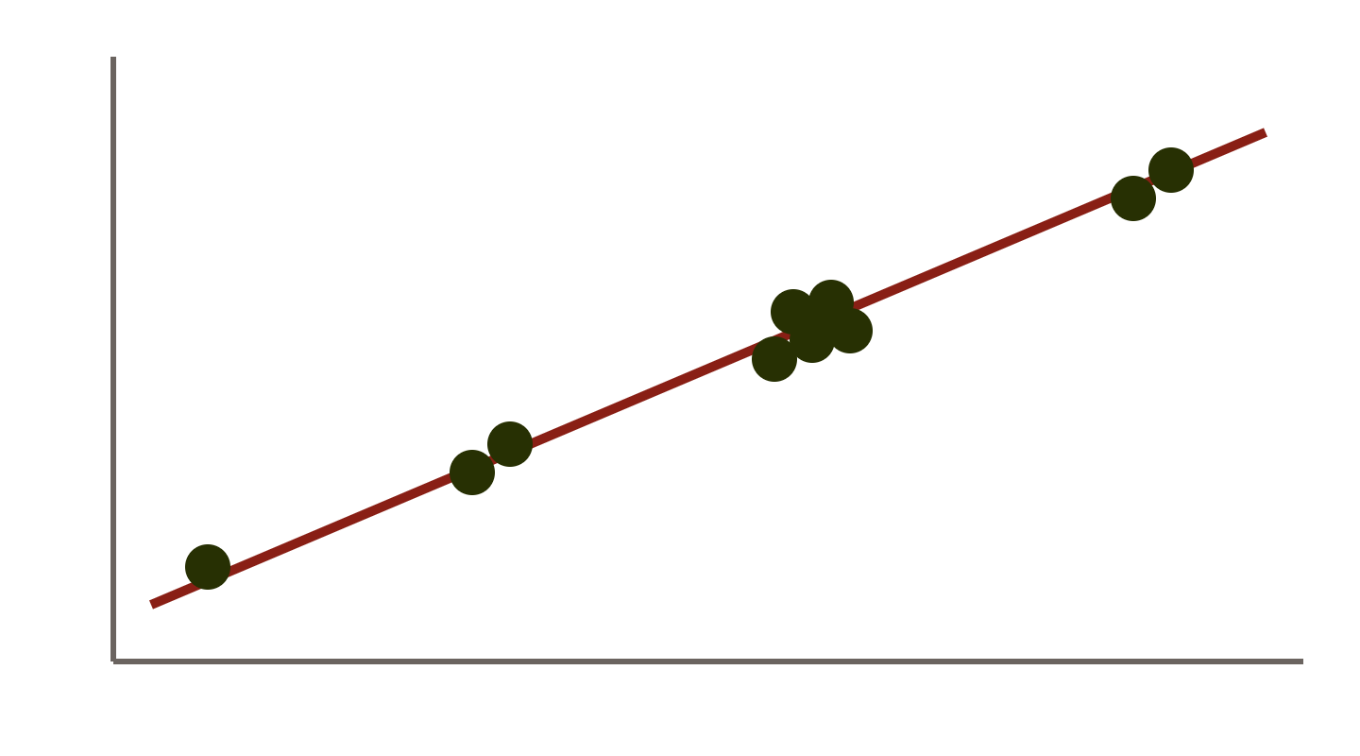
First: is there a temporal signal?
Root-to-tip regression: do isolates collected later carry more mutations since the root?
A clear positive slope, with a p-value from randomly permuting the dates, means the tree can be dated.
No clear slope: do not date the tree. Say the data cannot date the cluster.
↑ distance from the root
collection date →
Illustrative, not the ST39 data
Module 6 · Phylogenetics and outbreak detection | Day 7
34
Notes:
The tree is first rooted where the dates fit best. The slope of the line estimates the substitution rate. Permuting the dates tests whether a slope this steep could arise by chance. With year-only dates and most isolates from 2016 to 2019, the signal here may be weak: that is a result too.

Slide 35
Hands-on: BactDating in R
library(ape); library(BactDating); library(readr)
meta <- read_tsv(file.path(Sys.getenv("COURSE"),
"training_data/metadata_compact.tsv"))
tree <- loadGubbins("ST39")
tree <- drop.tip.useRec(tree, "Reference")
dates <- meta$collection_year[match(tree$tip.label,
meta$sample)]
names(dates) <- tree$tip.label
# 1. Temporal signal
rooted <- initRoot(tree, dates, useRec = TRUE)
roottotip(rooted, dates)
# 2. Time-scaled tree (a few minutes)
res <- bactdate(tree, dates, nbIts = 1e5,
useRec = TRUE, showProgress = TRUE)
res; plot(res, "treeCI"); plot(res, "trace")
loadGubbins: the Gubbins tree, with how much of each branch is free of recombination.
drop.tip.useRec: removes the undated Reference tip and keeps that information.
useRec = TRUE: recombined stretches do not count as clock-like change.
res: root date and rate, with credible intervals. The trace should look like a flat, hairy caterpillar.
Module 6 · Phylogenetics and outbreak detection | Day 7
35
Notes:
Run from $RESULTS/06_phylogeny/ST39 after use_tools r. The code is wrapped to fit the slide; copy it from the Day 7 page. loadGubbins reads ST39.final_tree.tre, the node-labelled tree and the per-branch statistics. For a country's own data, bin/run_bactdating.R does all of this for one group from the pipeline's Gubbins output, treats year-only dates as a whole year rather than a point, checks convergence, and can date the common ancestor of chosen isolates with --mrca.

Slide 36
What a date can tell the IPC team
THE CLUSTER'S COMMON ANCESTOR
Roughly when the lineage started diversifying in the unit.
LIMITS HERE
Dates are years only, most from 2016–2019: expect wide credible intervals.
Well before the first case? The lineage may have circulated undetected: colonised babies, an environmental reservoir.
Report "around year X", not a month. Honest uncertainty is a valid result.
Module 6 · Phylogenetics and outbreak detection | Day 7
36
Notes:
With full collection dates (day and month), as most surveillance systems record, the same analysis gives much tighter estimates. That is one reason the country metadata on Day 5 asked for full dates where they exist.

Slide 37
From evidence to action
DAY 7 · SESSIONS 3–4 · 13:30–17:00
The outbreak summary, and presenting it to the IPC team
Module 6 · Phylogenetics and outbreak detection | Day 7
37
Notes:
Sessions 3 and 4. Genomics is only useful if the people who act on it understand it. Session 3 writes a one-page summary; Session 4 presents it to an IPC team in a role play.

Slide 38
The one-page outbreak summary
1
Key finding: what you found and how confident you are
2
Isolates: how many, which ward, which period
3
Genomic evidence: ST, SNP distances in and outside the cluster, tree figure
4
Interpretation: probable or possible transmission; reservoir or new introduction
5
Limitations: only cultured, sequenced isolates; year-only dates; no environmental samples
6
Recommended actions: two or three, specific
Write "probable transmission within the neonatal unit", not "outbreak confirmed".
Module 6 · Phylogenetics and outbreak detection | Day 7
38
Notes:
Genomics supports or weakens an epidemiological hypothesis; it rarely settles it alone. Put the key finding first: busy readers may not get past it. State whether the conclusion held with both Snippy and SKA2.

Slide 39
Role play: the IPC meeting
You are the genomics lead. Are the 2017 Klebsiella bloodstream infections linked? 5 minutes to present, 10 for questions.
ROLES (GROUPS OF 4)
THE PANEL WILL ASK
Genomics lead
IPC nurse
Neonatologist
Microbiology lab manager
"So is it an outbreak or not?"
"Did it come from one baby, or from the unit itself?"
"What should we do on Monday morning?"
"Will treatment change?" (CTX-M-15 and gentamicin resistance: Day 4)
Agree on two actions: e.g. sampling sinks and incubators; a hand-hygiene and cleaning audit; screening new admissions; reviewing empiric antibiotics.
Module 6 · Phylogenetics and outbreak detection | Day 7
39
Notes:
Rotate the genomics lead so several trainees present. The IPC nurse and the neonatologist should push for plain answers; the lab manager can ask about sampling and turnaround. Good answers acknowledge uncertainty and still give a clear recommendation. The treatment question links back to Day 4: with CTX-M-15 and gentamicin resistance, both WHO first- and second-line regimens are predicted to fail for these isolates.

Slide 40
Check your understanding
1
Why does recombination make two isolates look less related than they are?
2
The cluster isolates are 0–5 SNPs apart. Does that prove baby-to-baby transmission?
3
Why use only the chromosome as the reference?
4
A pair is 8 SNPs apart by Snippy and 45 by SKA2. What do you check?
Module 6 · Phylogenetics and outbreak detection | Days 6–7
40
Notes:
Answers. 1: one recombination event can import a stretch of DNA from a distant strain, bringing dozens or hundreds of SNPs at once; counting them as mutations makes the isolates look as if they diverged long ago. 2: no. It shows a very recent common ancestor. Transmission could be direct (baby to baby, via hands) or from a shared source such as a sink, incubator or contaminated feeds; epidemiology decides. 3: plasmids are gained, lost and exchanged between lineages, so their SNPs do not follow the chromosome's history, and plasmid regions missing from some isolates shrink the core. 4: whether SKA2's extra SNPs come from a recombination block Gubbins removed from Snippy's alignment, or from genes or plasmids outside the reference; look at both trees, the recombination predictions and the isolates' QC. Until explained, the pair is at most possible transmission.

Slide 41

Checklist
DAY 6
DAY 7
ST39.treefile and ST39_snp_dists_filtered.tsv
Microreact project, coloured by ward and year
Raw and recombination-filtered distances compared
ST39 classification table completed
Min, median, max per pair type
Root-to-tip result; dated tree only if the signal supports it
Snippy vs SKA2: ST39_snippy_vs_ska.tsv and the pipeline summary
One-page summary; two actions agreed in the role play
Module 6 · Phylogenetics and outbreak detection | Days 6–7
41
Notes:
Optional on Day 6: build the ST35 tree yourself (CAAGNM CAAGJF CAAGM3 CAAG9G CAAHBT D46705), with the Shovill assembly with the fewest contigs as the reference, since there is no closed ST35 genome.

Slide 42
Further reading
Papers
Tools
Cornick J, et al. Genomic investigation of a suspected K. pneumoniae outbreak in a neonatal care unit in sub-Saharan Africa. Microb Genom 2021. PMC8743538
Derelle R, et al. Seamless, rapid, and accurate analyses of outbreak genomic data using split k-mer analysis. Genome Res 2024. doi:10.1101/gr.279449.124
Didelot X, et al. Bayesian inference of ancestral dates on bacterial phylogenetic trees. Nucleic Acids Res 2018.
Vos M. Why do bacteria engage in homologous recombination? Trends Microbiol 2009. doi:10.1016/j.tim.2009.03.001
Snippy, Gubbins, IQ-TREE
SKA2
BactDating
Microreact, iTOL
CSI Phylogeny
Module 6 · Phylogenetics and outbreak detection | Days 6–7
42

Slide 43
Questions?
Next: Day 8 · Capsule and O-antigen typing, and bringing results together
Module 6 · Phylogenetics and outbreak detection | Days 6–7
43
Notes:
Wrap up: we built a recombination-filtered tree and SNP distances for ST39, checked them with a reference-free method, classified the cluster with ward and dates, and turned it into actions for an IPC team.

